Slide 1

CIS 509 – FINAL PROJECT
UNSTRUCTURED DATA ANALYTICS
(USING YELP DATASET)
TEAM 441 – GROUP 2

Slide 2

AGENDA
INTRODUCTION AND BUSINESS CONTEXT
PROJECT GOAL AND SIGNIFICANCE
DATA SUMMARY
DATASET SELECTION
SOLUTION APPROACH
EXPLORATORY DATA ANALYSIS
SENTIMENT ANALYSIS
TOPIC MODELING
RECOMMENDATIONS & CONCLUSION
RECOMMENDATION SYSTEM

Slide 3

INTRODUCTION AND BUSINESS CONTEXT
In this presentation, we will take you through our journey of exploring Yelp data, the challenges faced, the methodologies employed, and the key findings that have the potential to drive strategic decision-making and operational excellence in the restaurant sector.
BUSINESS CONTEXT:
The idea behind our project is to:
Present our findings from a comprehensive analysis of Yelp data.
Uncover actionable insights for business development and enhancing customer satisfaction in the restaurant industry.
Stakeholders involved: restaurants, customers, employees, review platforms, and investors

Slide 4

PROJECT GOAL AND SIGNIFICANCE
GOAL:
To empower restaurant owners with a data-driven understanding of market dynamics in the city of Goleta, allowing for informed and targeted business development initiatives.
SIGNIFICANCE:
Help upcoming restaurant owners in understanding the general consensus of customers towards various restaurants.
Investigate why Yelp star ratings are dropping, which could affect all the stakeholders and thereby help them understand what works best.

Slide 5
DATASET SUMMARY AND ACQUISITION
01
Taken from the Yelp dataset (business.json)
150346 rows
14 columns
Contains details, attributes and stars of the businesses
Business Data
02
Taken from the Yelp dataset (review.json)
6990280 rows
9 columns
Contains review and user ids, the reviews, stars, and categories of reviews
Review Data
Notes:
Two datasets have been acquired from the Yelp platform for analysis. The first dataset, extracted from "business.json," comprises 150,346 rows and 14 columns. It includes comprehensive details, attributes, and star ratings of various businesses listed on Yelp.
The second dataset, sourced from "review.json," consists of 6,990,280 rows and 9 columns. This dataset encompasses user and review IDs, the content of reviews, star ratings, and categories associated with the reviews.
These datasets provide valuable insights into business profiles, customer reviews, and user interactions on the Yelp platform, facilitating comprehensive analysis and decision-making processes.

Slide 6
SOLUTION APPROACH
01
Merged the “review” and “business” files in a single data frame.
Merging into 1 DataFrame
02
We got the total number of businesses in each state, and then chose the state (CA) and the city (Goleta) for our analysis.
Choosing the State and the City
03
After deciding the state and the city, we chose a cuisine (Mexican Food) to finally start the analysis on.
Choosing the Cuisine
04
We then used Sentiment Analysis and Topic Modelling on the final dataframe to gather insights.
Analytics

Slide 7
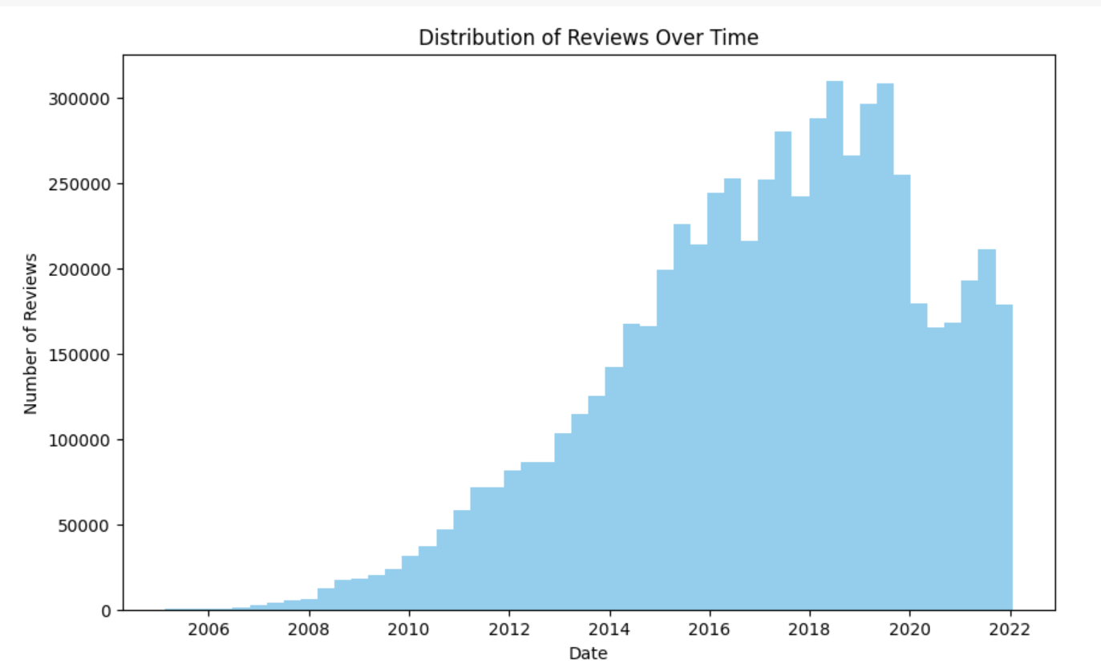
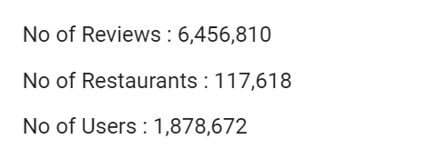
EXPLORATORY DATA ANALYSIS

Slide 8
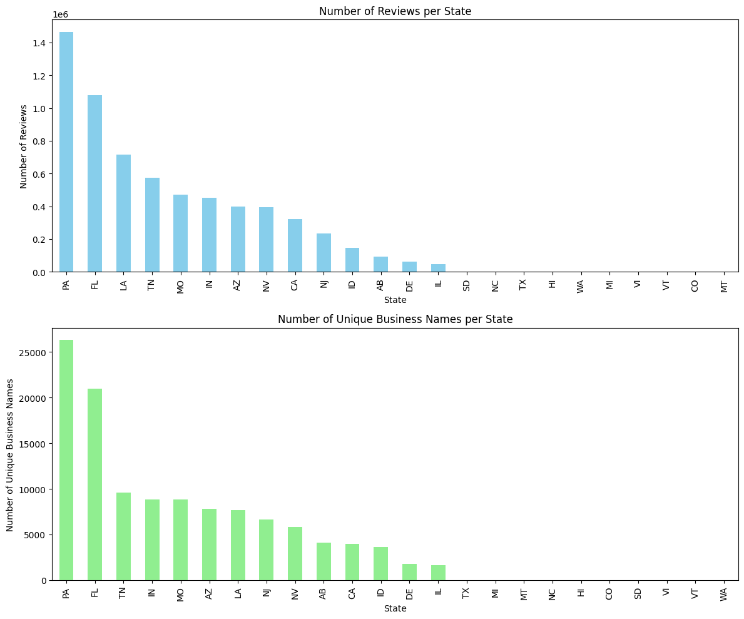
CA - Goleta - Mexican SELECTION
CA ranks 9th in the states with the most number of reviews with an average rating of 3.96 (7th highest)

Slide 9
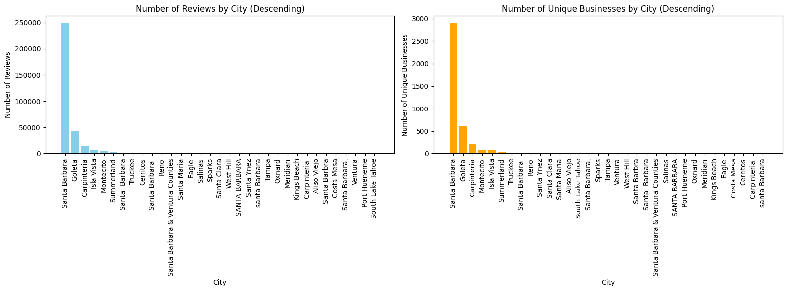
CA - Goleta - Mexican SELECTION
Goleta has the 2nd highest number of businesses in CA

Slide 10
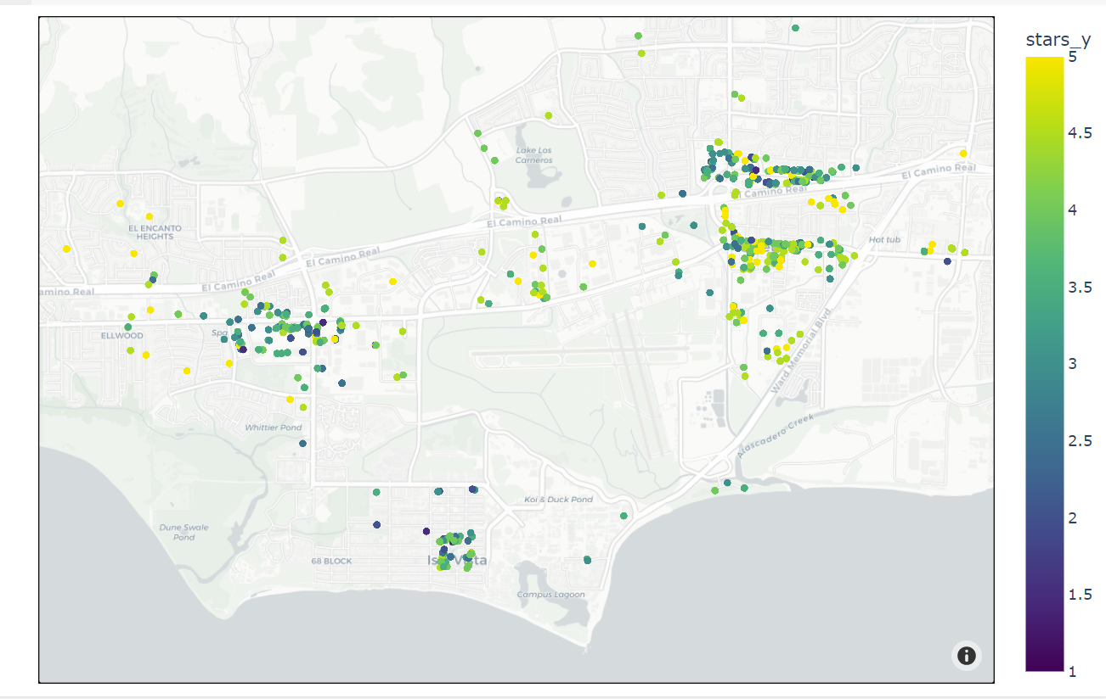
BUSINESS OVERVIEW OF GOLETA_CITY WITH RESPECT TO STAR RATINGS FROM REVIEWS

Slide 11
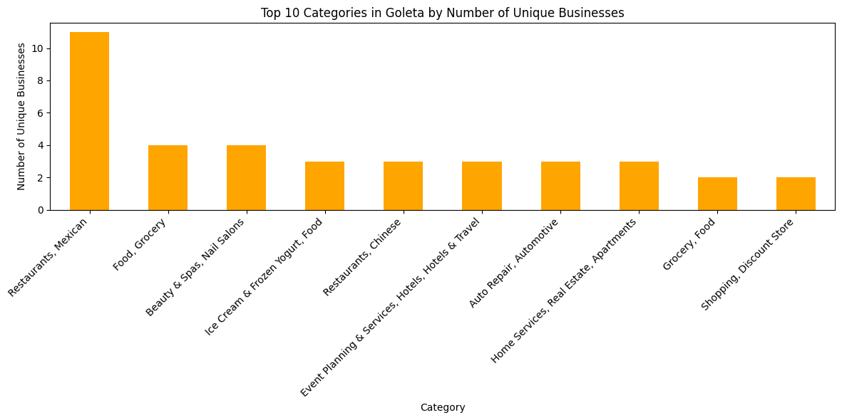
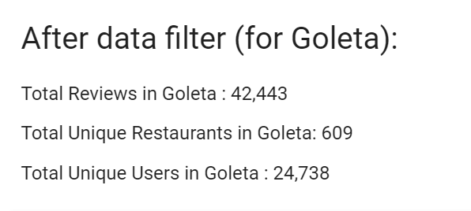
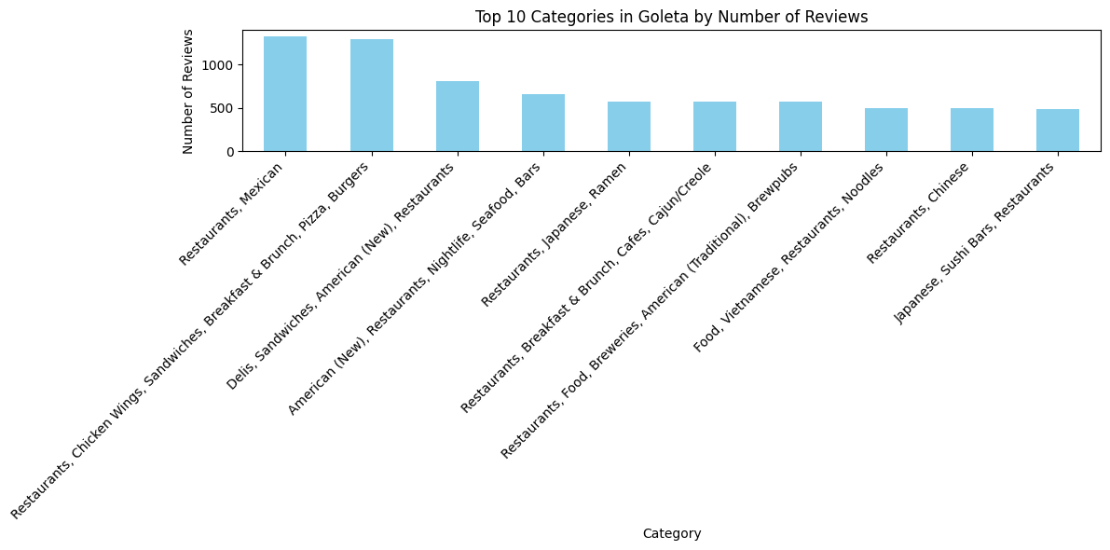
CA - Goleta - Mexican SELECTION

Slide 12
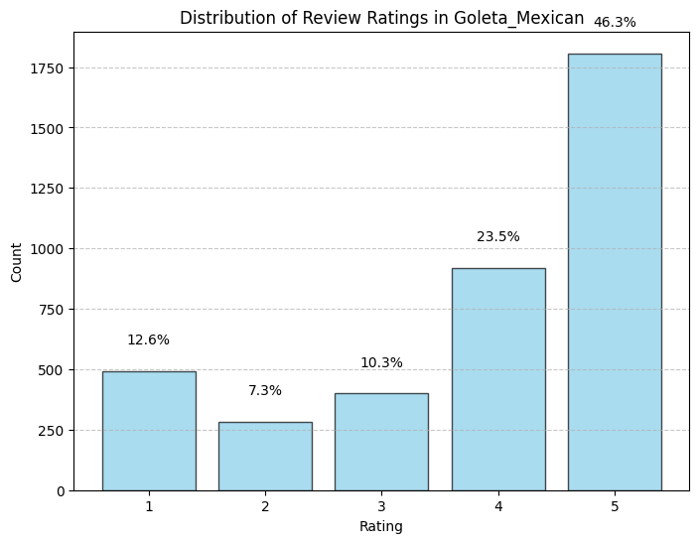
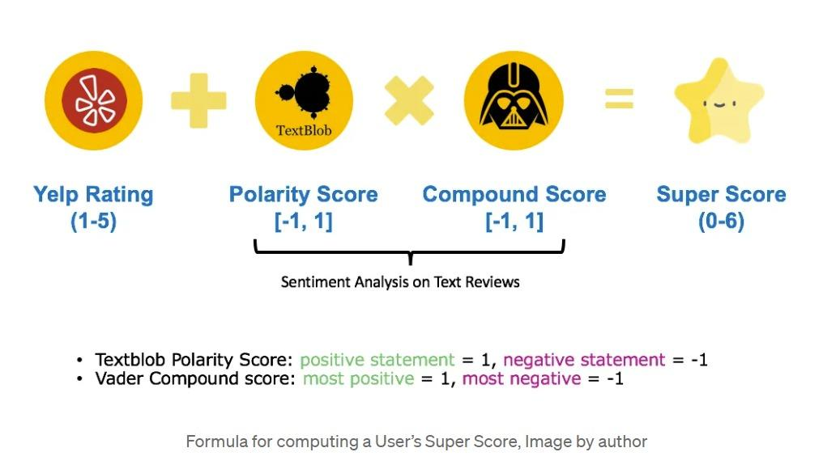
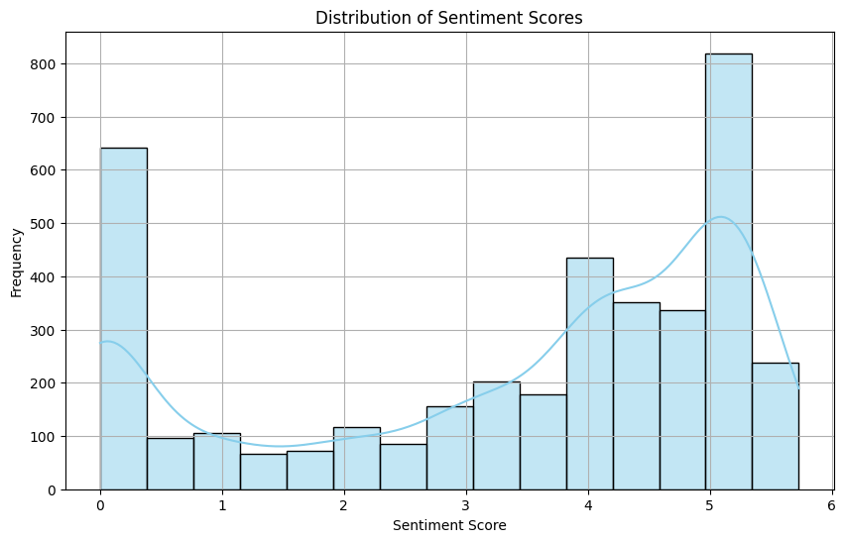
SENTIMENT ANALYSIS
-TextBlob
- Vader
(lexicon and rule-based sentiment analysis)

Slide 13
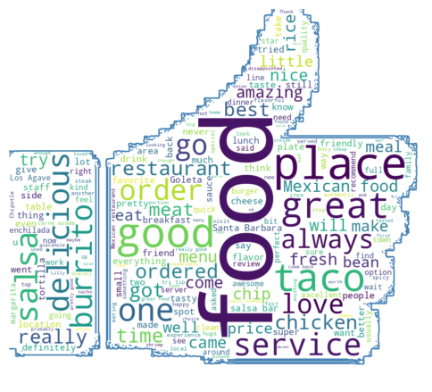
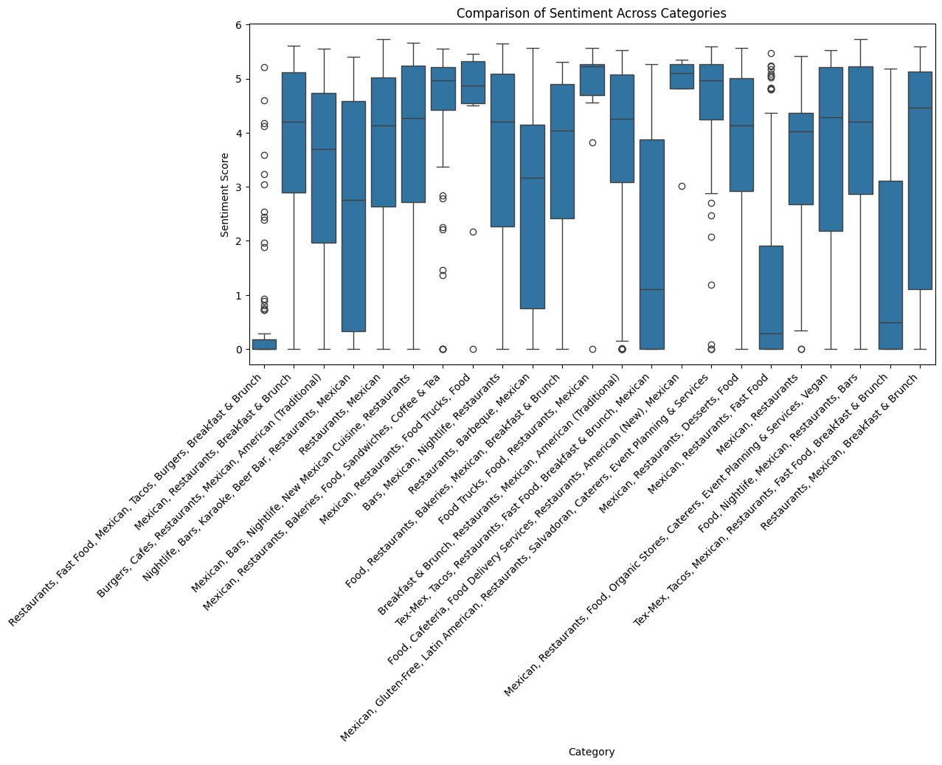
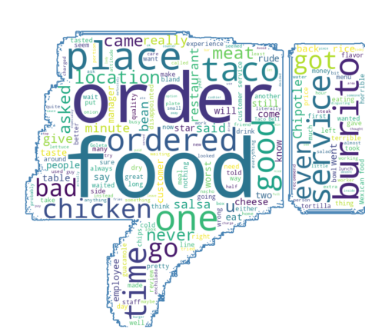

Slide 14
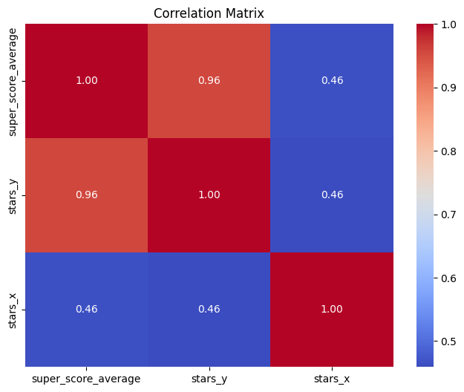
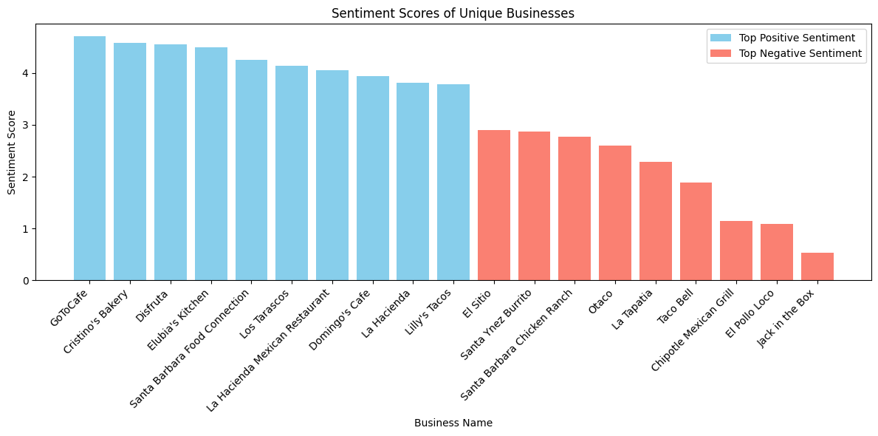

Slide 15
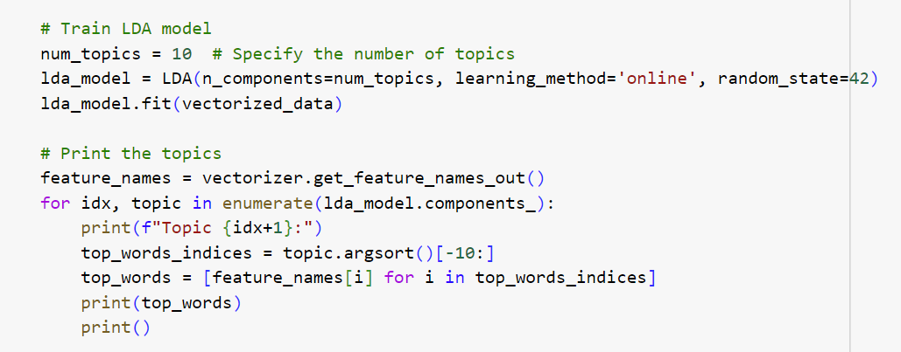
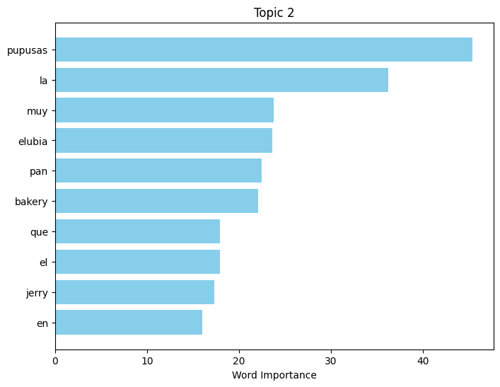
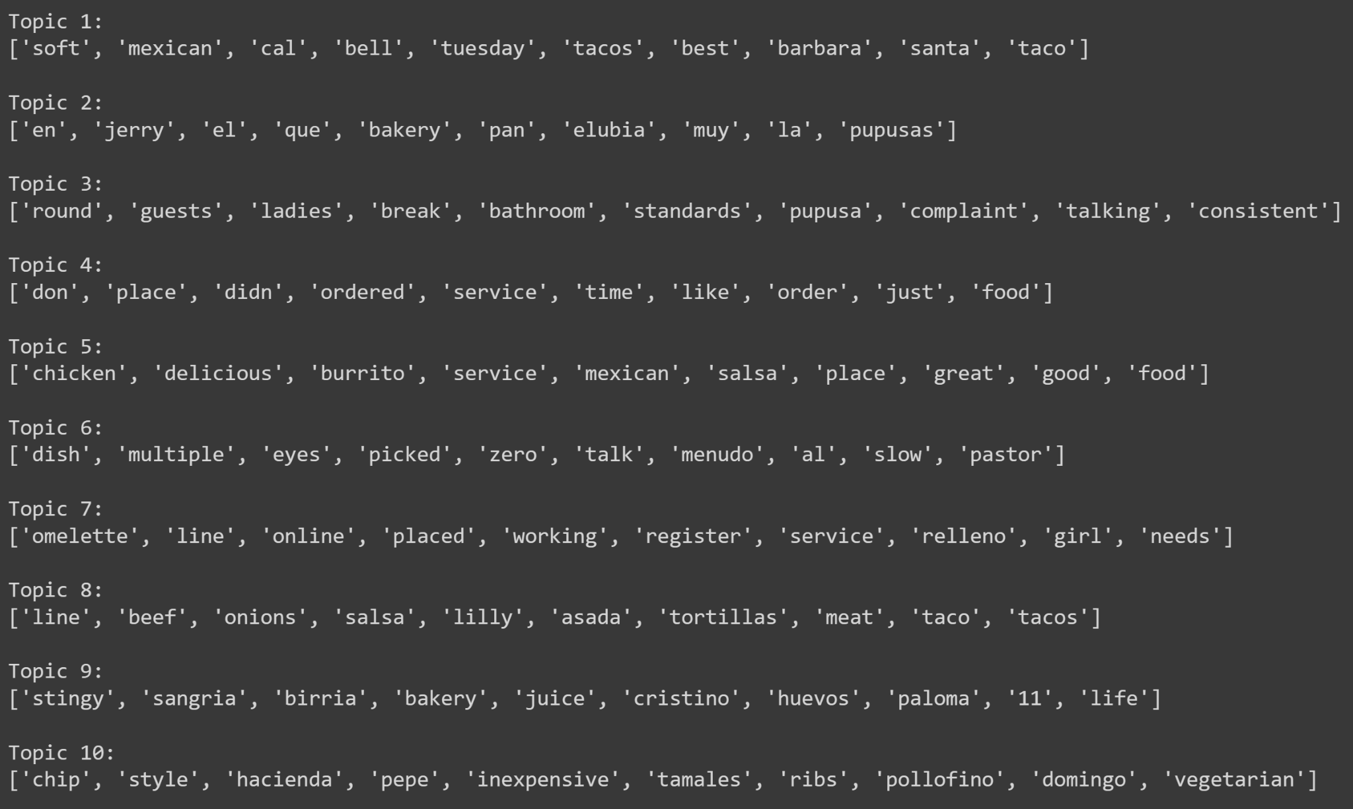
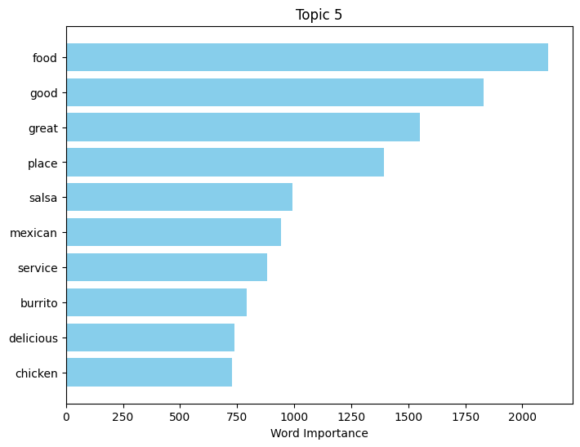
TOPIC MODELING

Slide 16
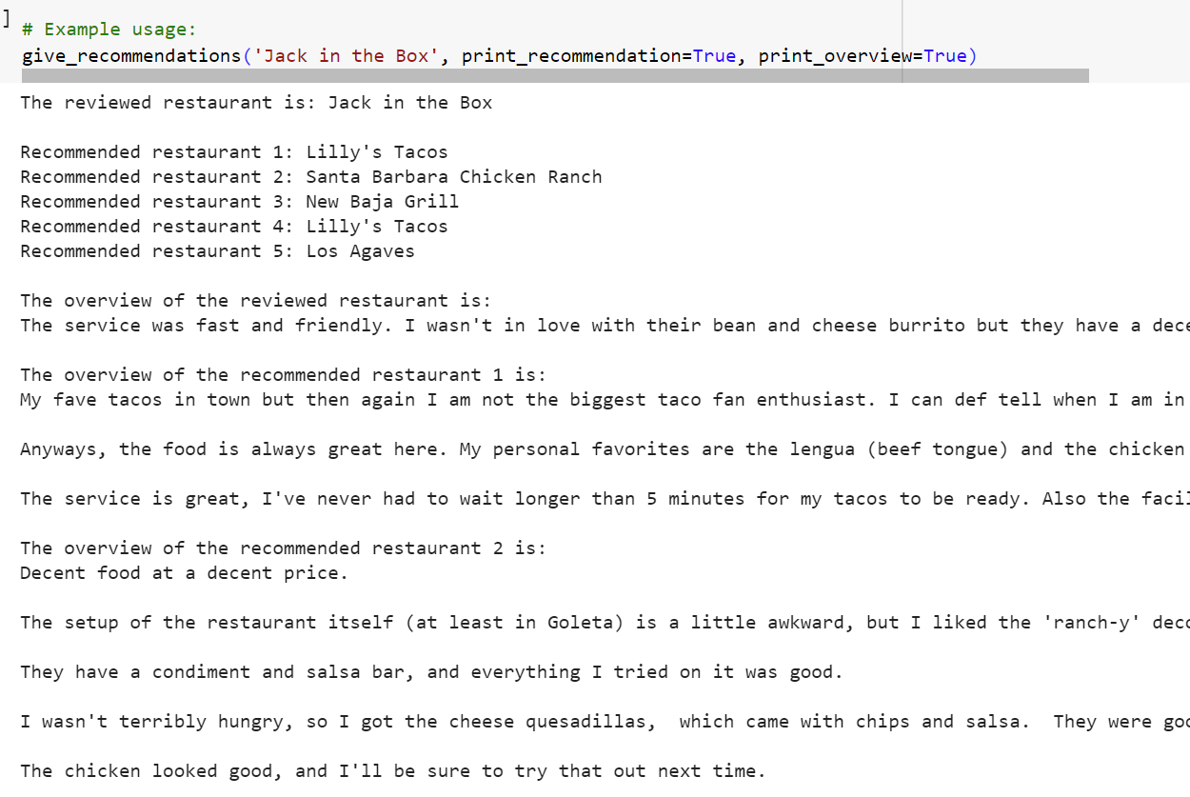
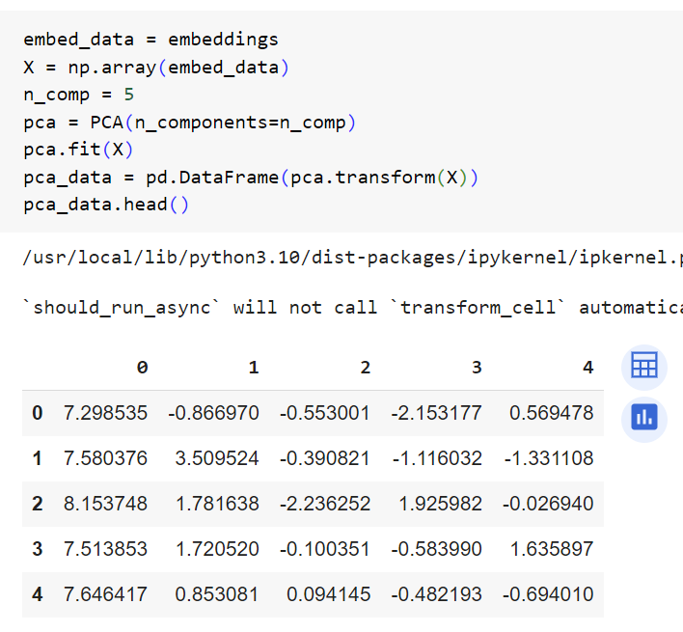
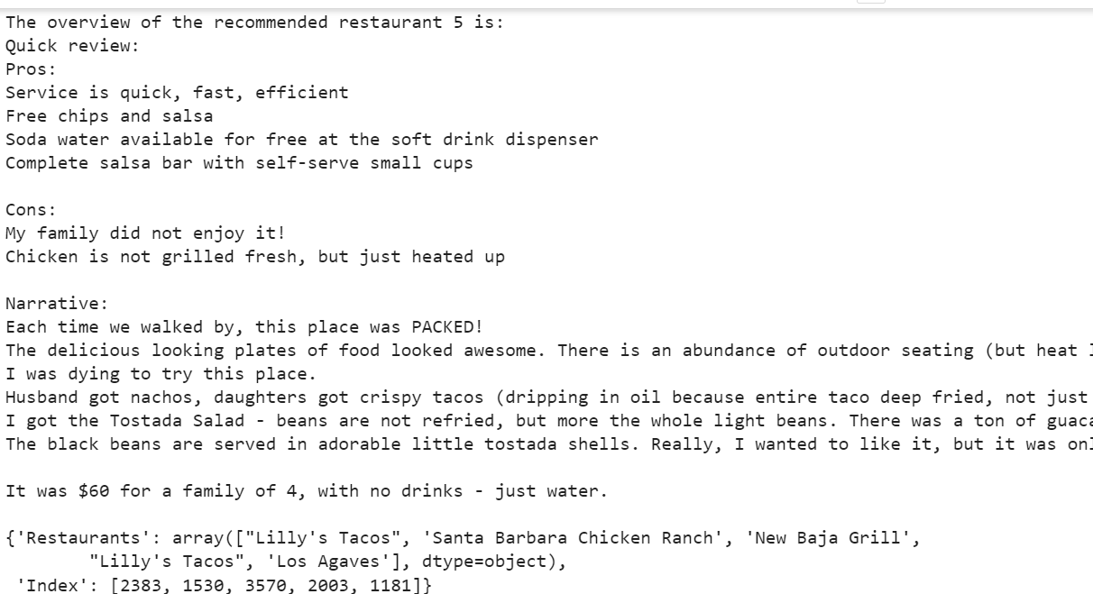
RECOMMENDATION SYSTEM
PCA _ Dimensionality Reduction is processed
Restaurant recommendations are made with the Top 5 restaurants and overview of the reviews from that restaurant.

Slide 17
RECOMMENDATIONS AND CONCLUSION
Local food trucks, cafe, and fast food more preferred
Mexican restaurants have the largest consumer base, yet high competition
Ensure good food quality, authenticity, timely service, and cleanliness

Slide 18
THANK YOU
TEAM 441 – GROUP 2

